Slide 1

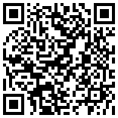




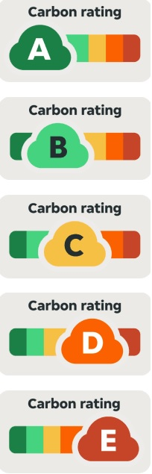



MENU WEEK 1
2025
MONDAY | Tomato & Chorizo Pasta 2, 7, 13 | 3 Cheese Macaroni Pasta 2, 7 | Tomato, Basil & Rocket Salad A/F | Caramel Sponge 2, 4, 7
TUESDAY | Sausage & Mash 2 | Spicy Quorn Slice 2, 7, 9 | Peas, Mash & Gravy 2 | Lemon & Blueberry 2, 4
WEDNESDAY | Chicken Roast 2/4 | Cauliflower & Broccoli Bake 2, 7 | Roast Potatoes & Vegetables A/F | Strawberry Shortbread 2, 13
THURSDAY | Chilli Salsa Chicken A/F | Five Bean Chilli 2 | Rice & Mexican Pepper Slaw | Orange & Lemon Traybake 2,4,13
FRIDAY | Battered Fish 2, 5 | South American Burrito 7 | Chips & Peas A/F | Selection of Puddings Ask on the day
ALLERGEN KEY
1. Celery
2. Gluten
3. Crustaceans
4. Eggs
5. Fish
6. Lupin
7. Milk
8. Molluscs
9. Mustard
10. Peanuts
11. Sesame
12. Soybeans
13. Sulphites
14. Tree nuts
A/F Allergen Free
"We are dedicated to minimizing our carbon footprint by actively reducing food waste throughout our operations, from sourcing to serving. Through staff training, supplier collaboration, and customer engagement, we are committed to making a positive environmental impact."
Catering provided by Greenshaw
Learning Trust.
All products are locally sourced
wherever possible.
All food is cooked fresh on the
school site each day.
Look out for Chef’s Specials
AVAILABLE DAILY
Wholemeal bread, fresh salads, a variety of seasonal fresh fruit, yogurts & jacket potatoes.
Please note that all our dishes can be adapted to suit the majority of dietary requirements

Slide 2
MENU WEEK 2
2025
MONDAY | Mediterranean Chicken A/F | Vegetable Tagine 2, 7, 12 | Moroccan, Cous Cous & Roasted Veg A/F | Sprinkle Cake 2 ,4
TUESDAY | Sweet Chilli beef Noodles 2, 4, 12 | Sweet and Sour Veg Noodles 2, 4, 12 | Oriental Salad 12 | Honey Ginger Cookie 2
WEDNESDAY | Roast Chicken & Yorkshire 2, 4 | Quorn Sausage Roast & Yorkshire 2, 7 | Roast Potatoes & Vegetables A/F | Chocolate Crunch 2, 4, 7, 12
THURSDAY | Katsu Chicken Curry 7 | Nepalese Curry 12 | Rice & Cucumber Coriander Raita, Baby Carrots A/F | Pear Crumble Cake 2, 4
FRIDAY | MSC Fish Fingers 2, 5 | Quorn Nugget 2, 4, 7,12 | Chips & Peas A/F | Selection of Puddings Ask on the day
ALLERGEN KEY
1. Celery
2. Gluten
3. Crustaceans
4. Eggs
5. Fish
6. Lupin
7. Milk
8. Molluscs
9. Mustard
10. Peanuts
11. Sesame
12. Soybeans
13. Sulphites
14. Tree nuts
A/F Allergen Free
"We are dedicated to minimizing our carbon footprint by actively reducing food waste throughout our operations, from sourcing to serving. Through staff training, supplier collaboration, and customer engagement, we are committed to making a positive environmental impact."
Catering provided by Greenshaw
Learning Trust.
All products are locally sourced
wherever possible.
All food is cooked fresh on the
school site each day.
Look out for Chef’s Specials
AVAILABLE DAILY
Wholemeal bread, fresh salads, a variety of seasonal fresh fruit, yogurts & jacket potatoes.
Please note that all our dishes can be adapted to suit the majority of dietary requirements

